Slide 1
Hack verse 2022 Life Expectancy Prediction & Statistical Analysis on factors influencing Life Expectancy
MSC Data Science
(Nitish , Yash , Sachin , Jayesh)

Slide 2
Agenda
EDA (Exploratory Data Analysis)
Background & Problem
Dataset Description
Data Pre-Processing
Model & Variable Selection
Results
Conclusions

Slide 3
EDA (Exploratory Data Analysis)
Now that we have an overview of the case and a formal problem statement, the very next stage is to explore and understand the data. This is also called the Exploratory Data Analysis (EDA) step. In this section, we will load the data into our analysis environment and explore its properties. It is worth mentioning again that EDA is one of the most important phases in the whole workflow and can help with not just understanding the dataset, but also in presenting certain fine points that can be useful in the coming steps.

Slide 4
Background & Problem
Analytics Question:
1) Do all the features available in the dataset really affect the Life expectancy? What are the predicting
variables actually affecting the life expectancy?
status, Adult Mortality, percentage expenditure , HIV , GDP , schooling , Income composition of resources
2) Should a country having a lower life expectancy value(&lt;65) increase its healthcare expenditure in order
to improve its average lifespan?
3) How does Infant and Adult mortality rates affect life expectancy?
LE is is inversly propotional to Adult mortality
LE do not have much relation with infant death

Slide 5
Analytics Question:
4) What is the impact of schooling on the lifespan of humans?
Schooling improves lifespan of humans
5) Does Life Expectancy have positive or negative relationship with drinking alcohol?
drinking alcohol is positively correlated to LE
6) Do densely populated countries tend to have lower life expectancy?
False, Densely Pouplated countries have higher LE
7) What is the impact of Immunization coverage on life Expectancy?
considering Polio as immunization process, we can observe that with in increase in polio immunization we LE is inreasing in countries.

Slide 6
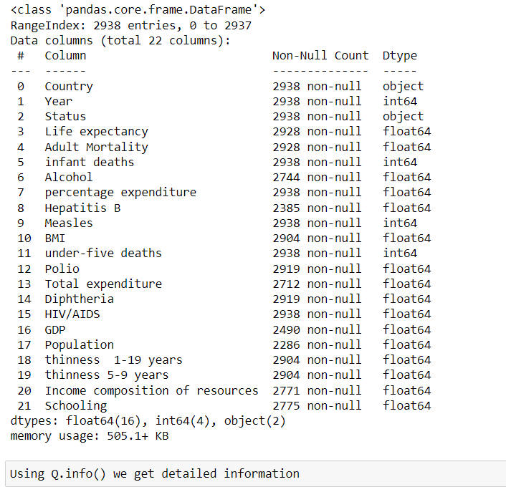
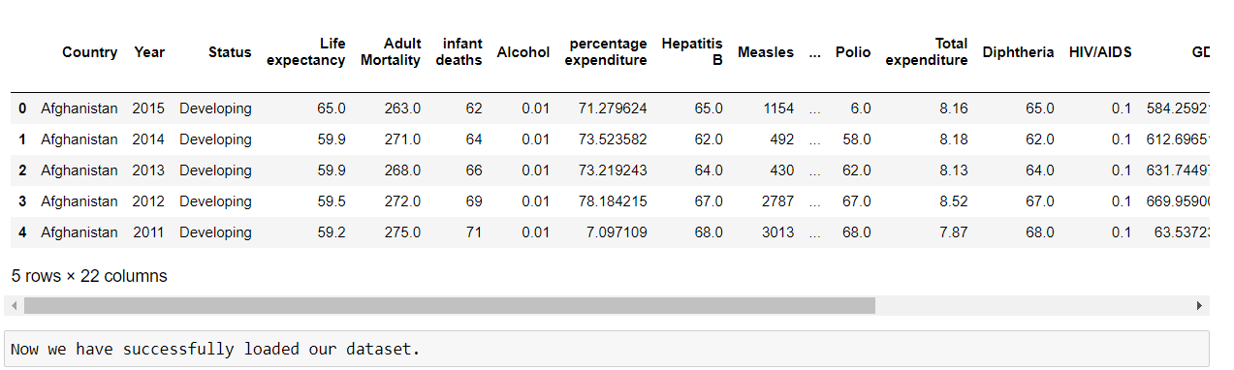
Dataset Description
As it is showing there are 2938 records and 22 features.

Slide 7
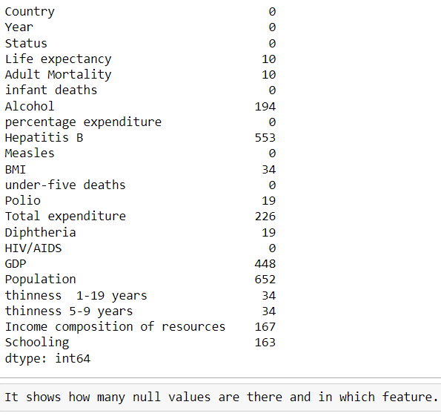
Dataset Description

Slide 8
Data Pre-Processing
The EDA process begins with loading the data into the environment, getting a quick look at it along with count of records and number of attributes. We will be making heavy use of pandas and numpy to perform data manipulation and related tasks. For visualization purposes, we will use matplotlib and seaborn along with pandas' visualization capabilities wherever possible.

Slide 9
Model & Variable Selection
Parametric Models To Adress Heteroskedasticity And Dimensionality:
Weighted Least Squares
Ridge,LASSO
Principal Component Regression, Partial Least Squares
Non Parametric Models:
Regression Tree
Random Forest
Two Model Specification: 17Variables(Full) & 14 Variables(Reduced)
There Is No business restriction to keep all predictors in the model
Stepwise and best subset were run to select a reduced model
Both methods suggest the same set of 14 variables to be included

Slide 10
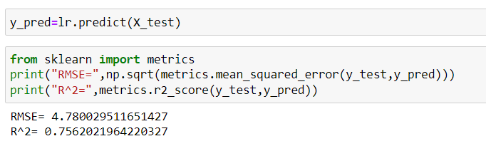
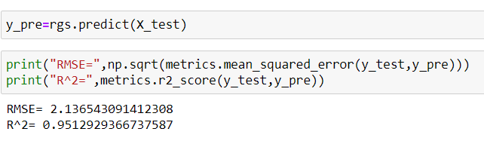
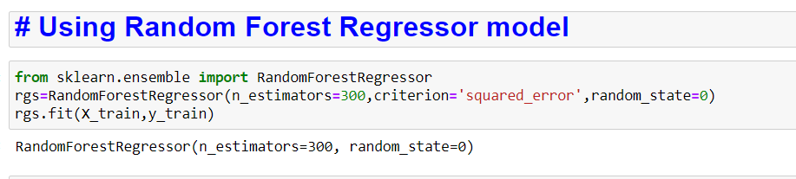
Results
Linear Regression model
(1 st model with initial accuracy)
Forest Regressor model
(2nd model with improved accuracy)

Slide 11
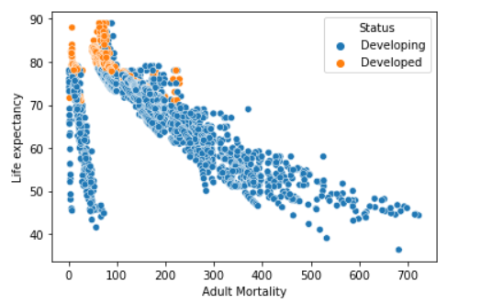
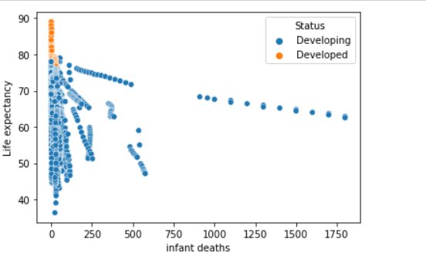
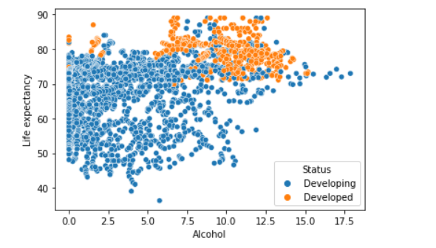
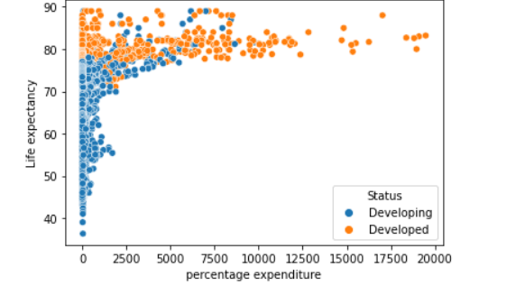
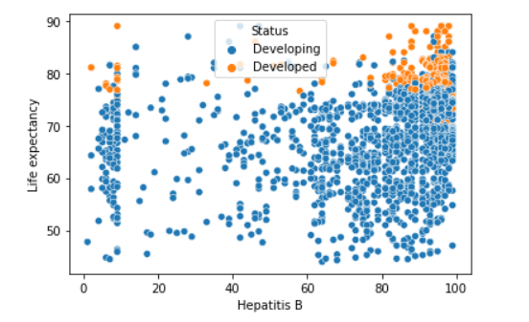
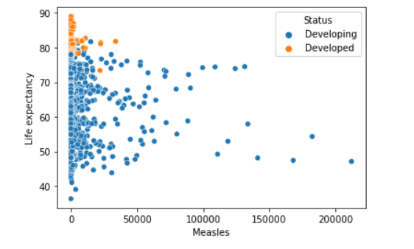
Data Visualisation : Graphs

Slide 12
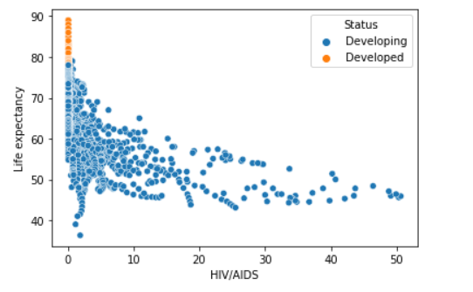
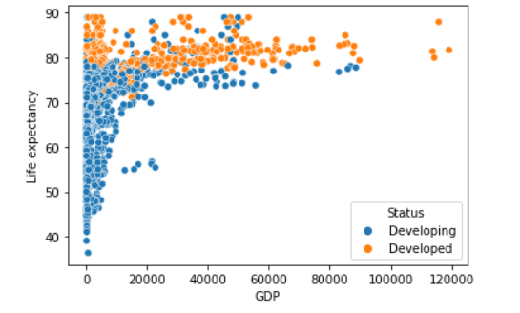
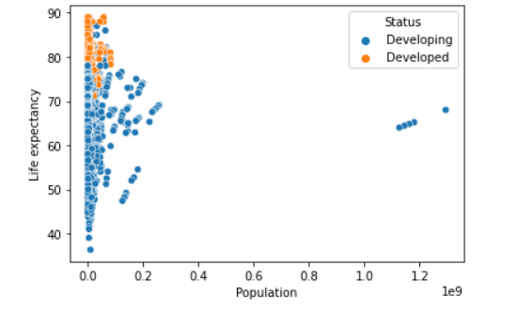
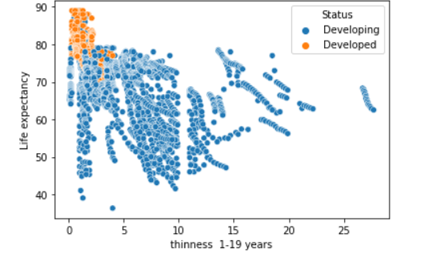
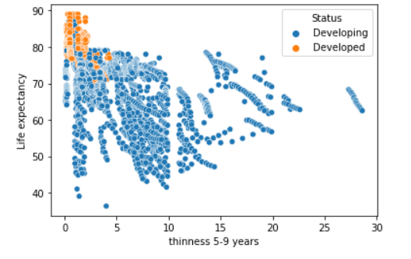
Graphs

Slide 13
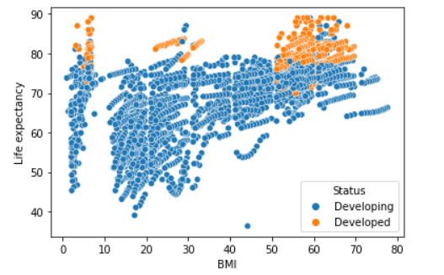
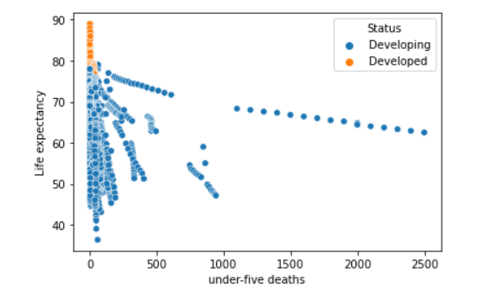
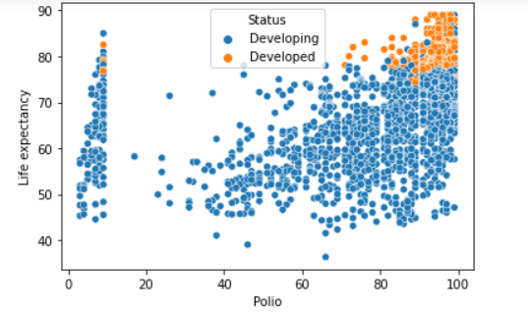
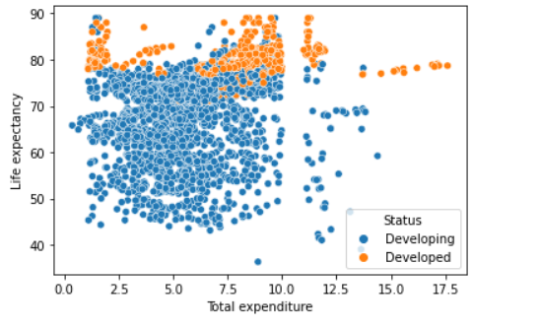
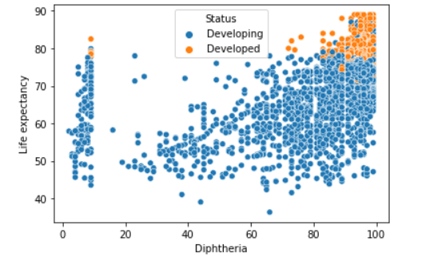
Graphs

Slide 14
Graphs and it's Conclusion
1) As adult mortality increased life expectancy decreases.
2) As infant death increases Life expectancy decreases.
3) Alcohol does not show any significant impact on life expectancy, but it’s greater consumption shows low life expectancy especially in developing countries.
4) Percentage expenditure also does not show any significant impact on life expectancy, but it's increase does not decreases the life expectancy.
5) Hepatitis B also not show impact on life expectancy probably due to increase of vaccination and awarenss about it.
6) If measles is more then life expectancy is less.

Slide 15
7) If polio is more then life expectancy is less mostly in developing countries, but is also does not show negative impact all the time,especially in developed countries probably due to increase of vaccination drives about polio and it's awareness.
8) If HIV/AIDS is more then life expectancy is less.
9) As we ca see from the graph that if population is more then life expectancy is low.
10) If thinness is more then life expectancy is expected to be less.
11) If income composition of resources is more then life expectancy is more mostly in developed countries.
12) If Schooling is more then life expectancy is more, here also this case is more in developed countries.
13) Also the heatmap shows the positive relation between Life expectancy and Alcohol,percentage expenditure,Hepatitis B, BMI, Polio, Total expenditure, Diphtheria, GDP, Income composition of resources and Schooling
14) It shows positive relation to certain diseases it means healthcare system work probably good in those cases and awareness campaigns and vaccination drives should have helped a lot in this
15) It shows negative relation with rest of the features means inverse relation to life expectancy.
16) Though we have been seen as successful in combating Hepatitis B,Polio,Diphtheria and health issues due to alcohol, we need an improvement in the areas like Measles, under five deaths, HIV/AIDS, thinness and population control.

Slide 16
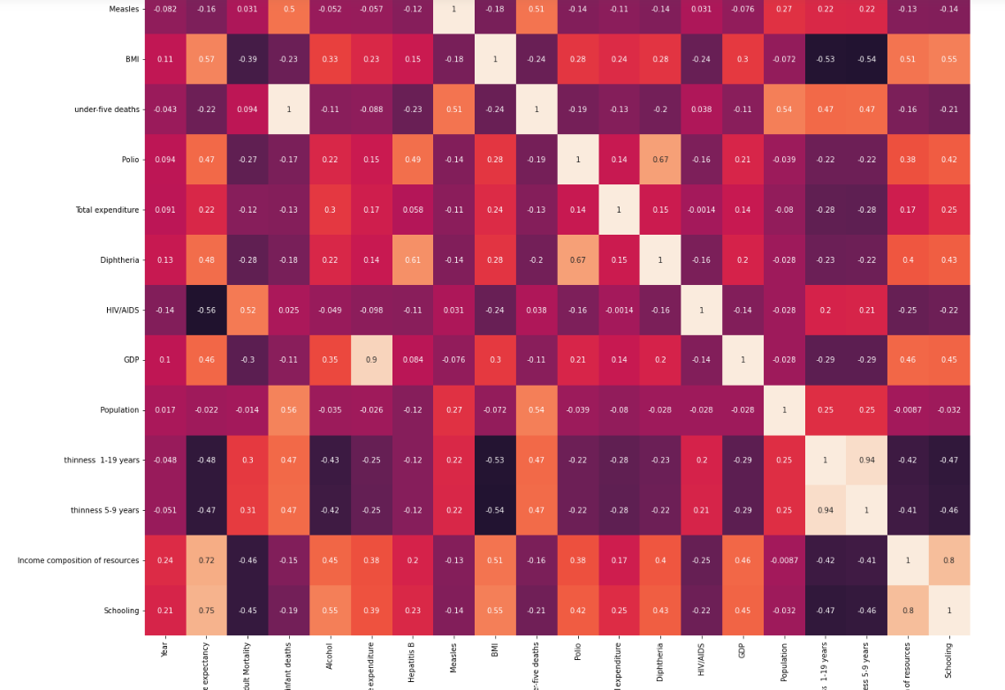



Heat Map
There seems to be some some strong collinearity, denoted by boxes in circle as you can see in the image above

Slide 17
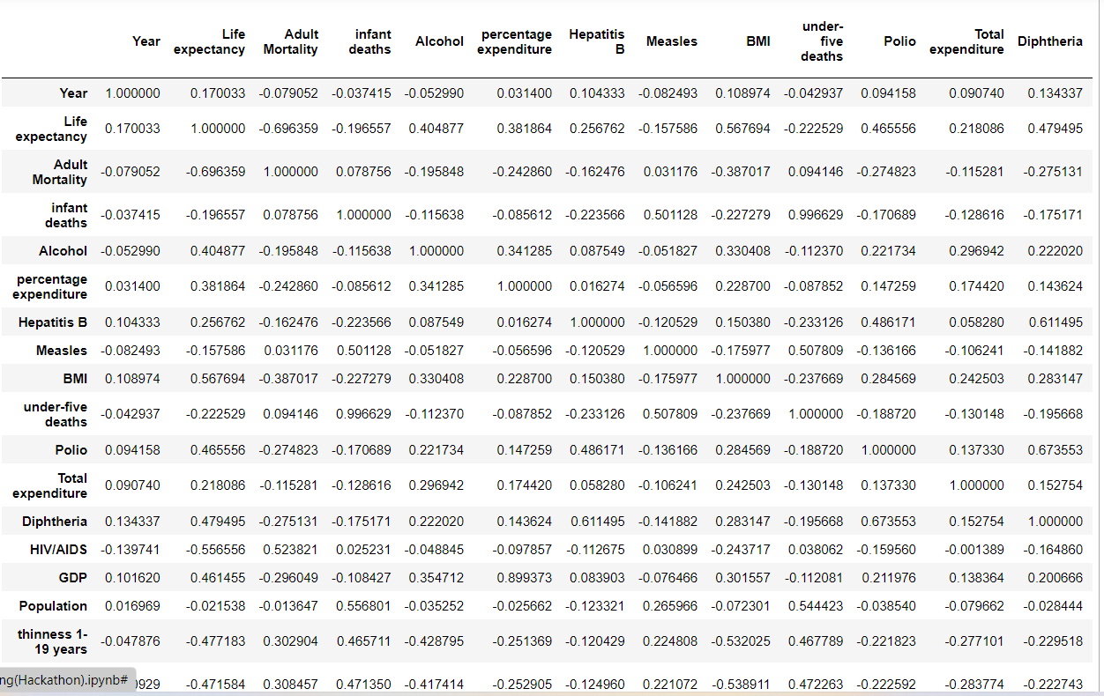
Full Model

Slide 18
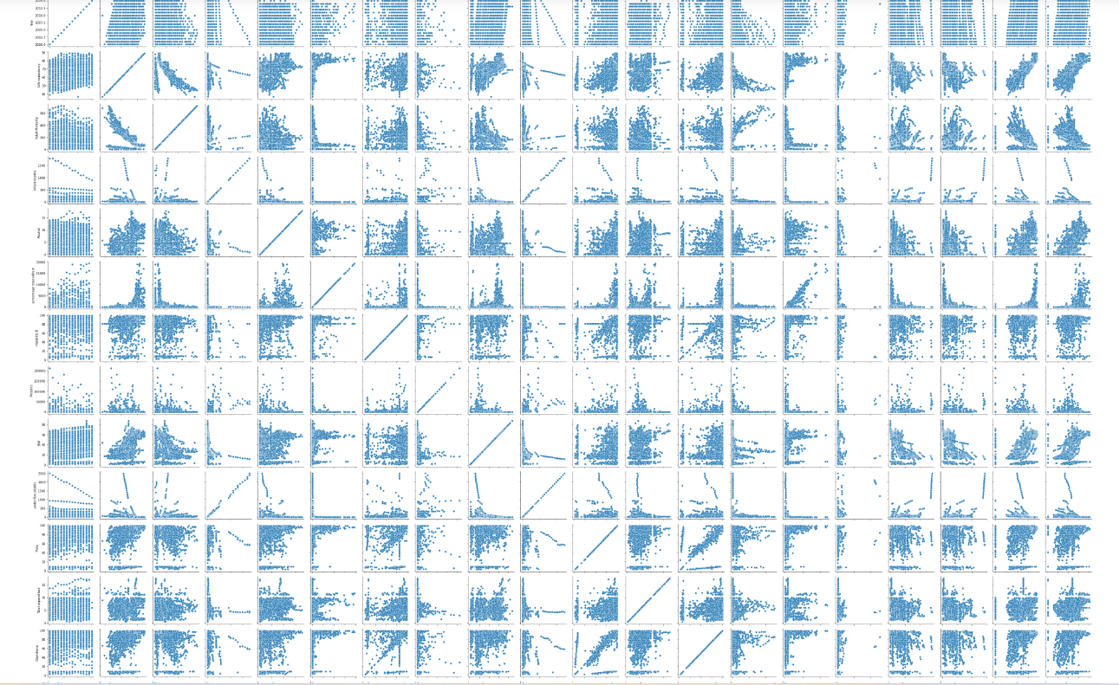
Outliers
Scatter
Plot
Each outlier is replaced by the next highest value in the column. After removing the outliers, the plots are still skewed to the right (points are very concentrated on the left side). So this suggests that some transformation might be needed.

Slide 19
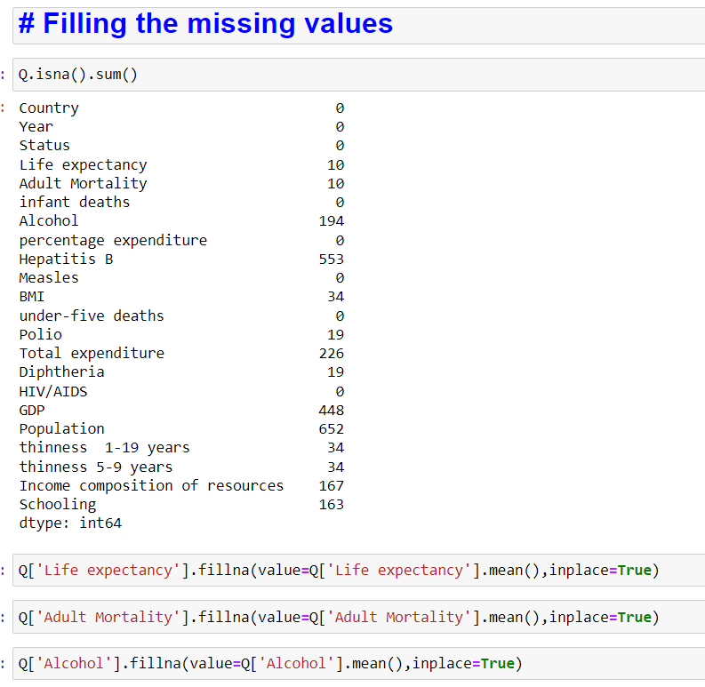
Filling The Missing Values
As we cannot predict the accuracy
With this null values that’s why we use Filling The Missing Values

Slide 20
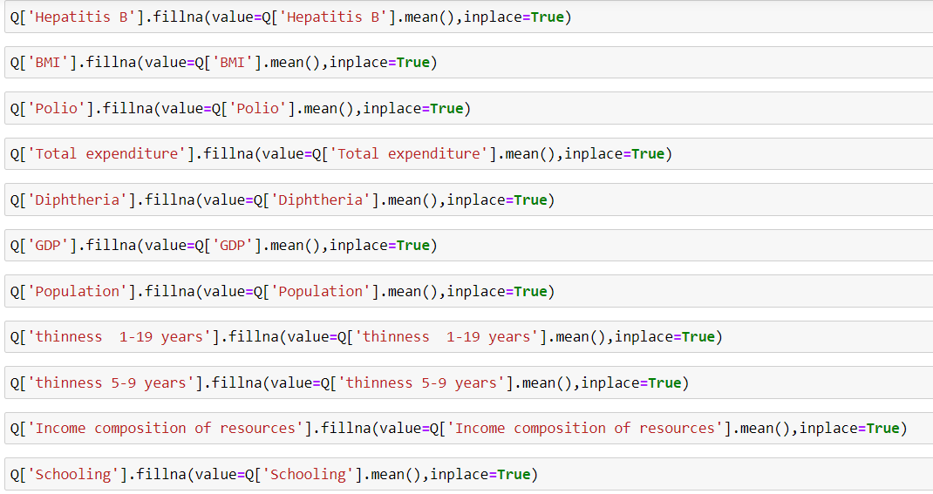
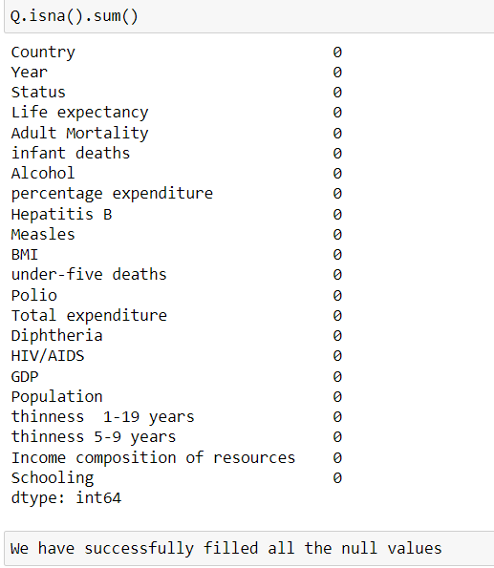

Slide 21
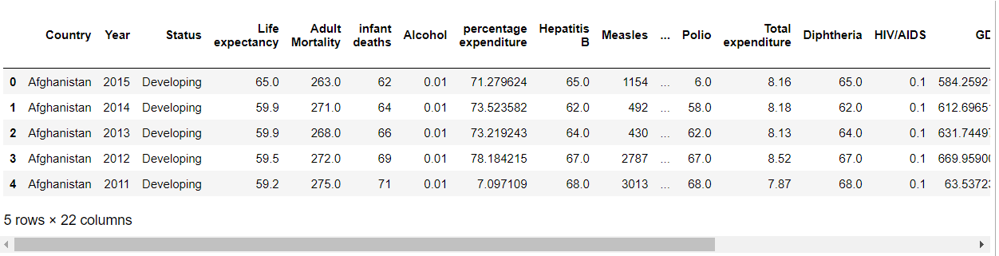
Machine Learning Deployment

Slide 22
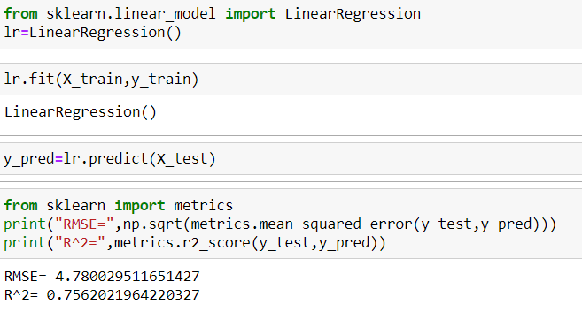
Assigning The Dependent And Independent Variable
Splitting The Dataset
Using Linear Regression Model

Slide 23
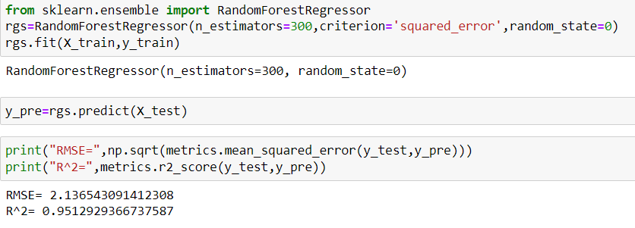
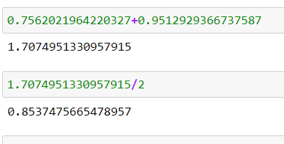
Using Random Forest Regressor Model
For Calculating Accuracy
Using Linear Regression Model+Using Random Forest Regressor Model=/2
R^2+R^2=/2

Slide 24
Conclusion
Linear Regression model gives 75.62% accuracy whereas Random Forest Regressor model gives us 95.14% accuracy which i consider excellent and fit to use for further predictions
There is no single predictor of life expectancy. There are things that contribute to life expectancy that is not in this dataset. But, based on the data used in this project, multiple factors greatly affects the life expectancy. The factors that had the most impact on life expectancy are number of deaths from HIV AIDS, number of years in school, and the body mass index of the population.Using these factors, one can predict the life expectancy of a population using health, social, and economic variables. It would be a stretch to use this information to predict the life expectancy of an individual because there are many more life variables involved than the variables presented in this project. This project and data analysis is most useful at predicting life expectancy at the population level.

